Slide 1





SOFTWARE TOOLS FOR SIMULATION AND OPTIMIZATION
SOFTWARE TOOLS FOR SIMULATION AND OPTIMIZATION
Simulation Study of the Coffee Shop
Simulation Study of the Coffee Shop
Abdelhaimd Farhat | 222008524 Mohamed Khirey | 221018105 Mahmoud Gomaa | 221018253

Slide 2









System
Process "Production"
Process "Transport"
Process "Coffee Shop"

Slide 3




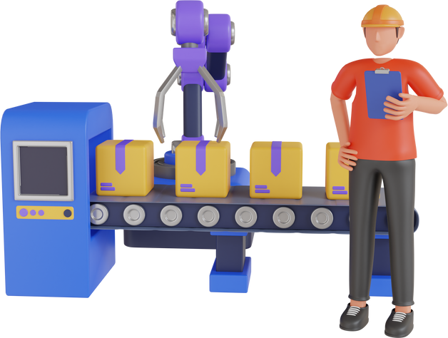

Production
Chocolate
Dough
Hazelnuts
Exp(λ) λ = 2
Exp(λ) λ = 5
Exp(λ) λ = 3
Needs:
1 dough
3 Hazelnuts
Needs:
1 dough
2 chocolate
Machine C
Machine H
U(a,b) a,b =5,35
U(a,b) a,b =5,35

Slide 4
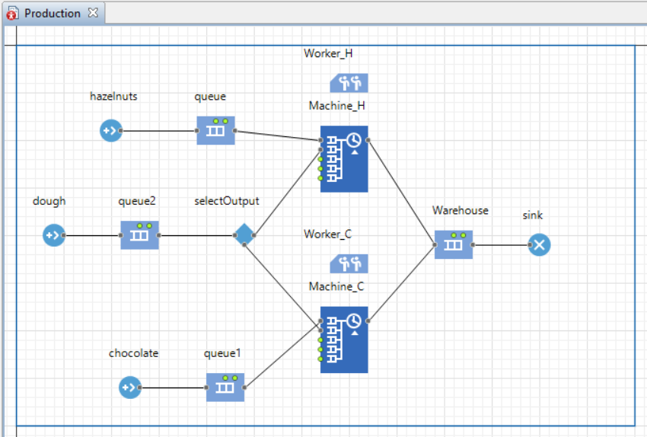


Production Simulation

Slide 5


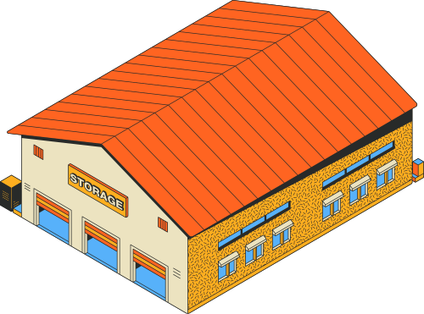



Transport
Warehouse
Coffee Shop
Outward journey
Return journey
Triang (a, b, c) a, b, c = 5,20,10
Triang (a, b, c) a, b, c = 5,20,10

Slide 6
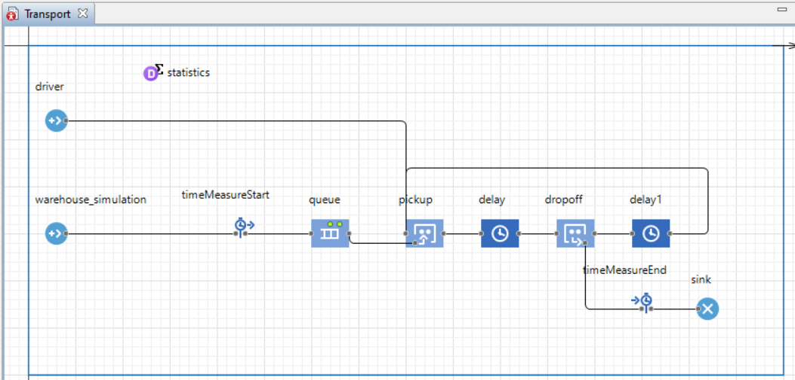

Transport Simulation

Slide 7









Coffee Shop
Prices:
Chocolate Cookie: €5
Hazelnut Cookie: €5
Coffee: €5
Espresso: €3
Customer
Customer Service
Shelf
Dining Area
Arrival : 5 per min
Preferences:
Chocolate: 40% Hazelnut: 60% Coffee: 70% Espresso: 30%
Matching area
Triang (a, b, c) a, b, c = 5,15,20
Clean Time: Gamma (𝛼,B) 𝛼,B = 5,1
N(𝜇,σ2) 𝜇,σ2 =2,17
After 10 min goes
30% Queue up again

Slide 8
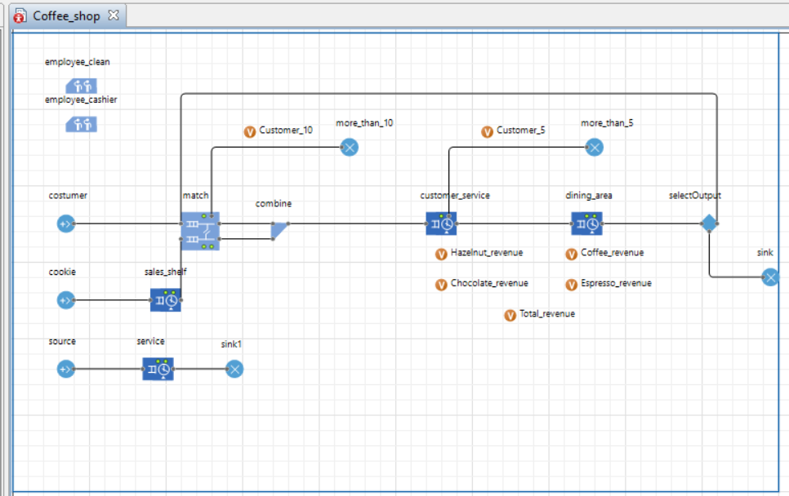
Coffee Shop Simulation

Slide 9
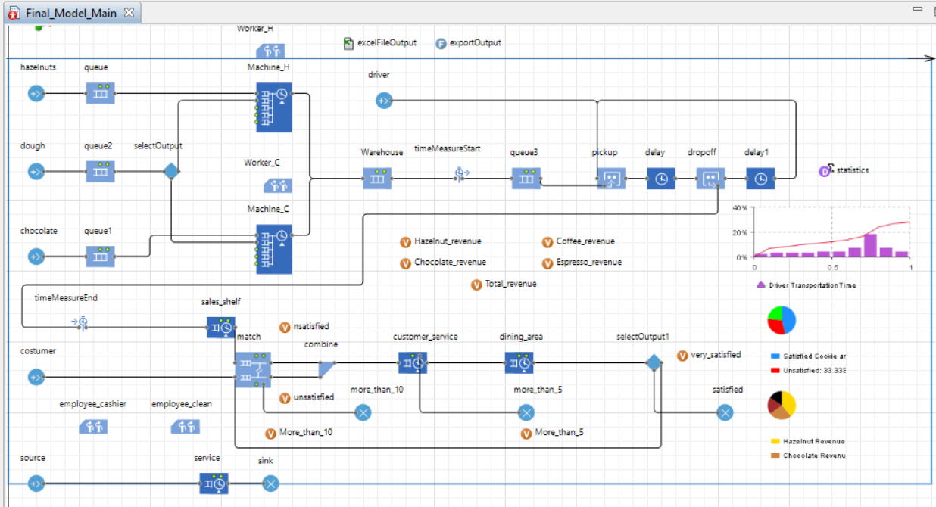
Original Simulation Together

Slide 10
Results

Slide 11






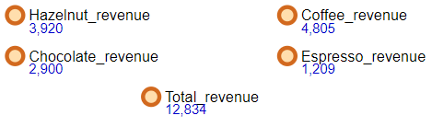
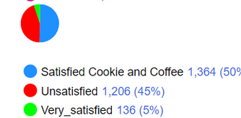
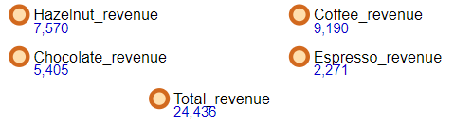
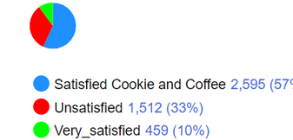

Metrics
Revenue
Customer Satisfaction
Original
1 employees
Original
2 employees

Slide 12



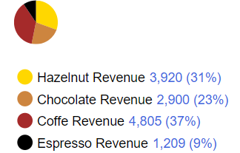


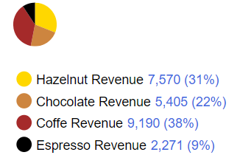

PROBLEMS AND POSSIBLE IMPROVEMENTS
Coffee Revenue
Customer Insatisfaction
Original
1 employee
Original
1 employee
Original
2 employees
Original
2 employees

Slide 13



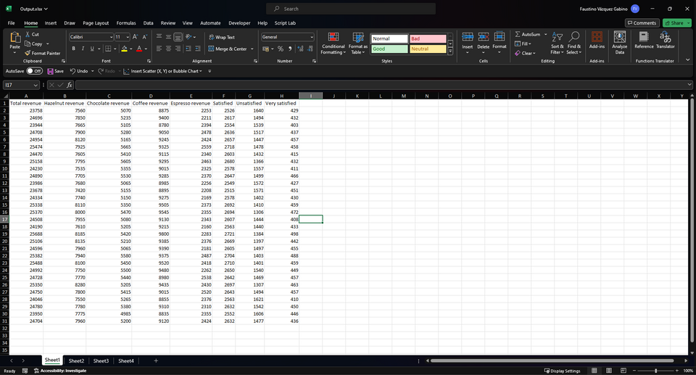
Analysis of Results
Data from 30 replications

Slide 14




Thank you!

